Slide 1
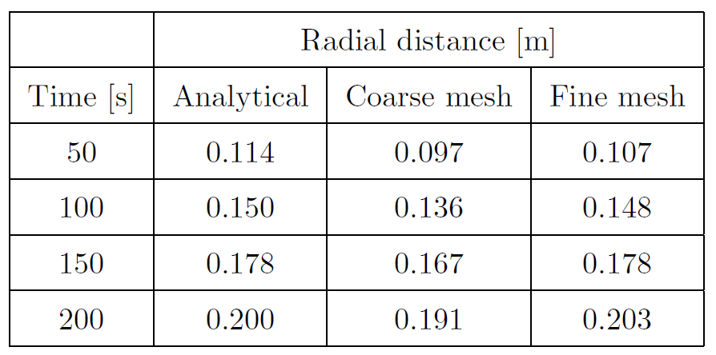
Estimation of the radial flow front after 200 s for a coarse and a fine mesh:
Estimation of the elliptical flow front after 200 s for a coarse and a fine mesh:
Flow front positions at different time instances calculated with an analytical formula, a coarse and a fine mesh:
Simulation input is porosity 0.70, permeability 3.0∙10⁻¹⁰ m² in first principal direction, 30° to the horizontal and permeability 1.5∙10⁻¹⁰ m² in second principal direction. An algorithm for determining the flow front position from an optical permeameter was adapted to calculate the permeablity: The results are 2.91∙10⁻¹⁰ m², 1.41 ∙10⁻¹⁰ m² and angle 30° for the fine mesh and 2.43 ∙10⁻¹⁰ m², 1.17 ∙10⁻¹⁰ m² and 29° for the coarse mesh. For the fine mesh (2198 cells for a domain with 600 × 600 mm), this reverse engineering shows very good agreement of the calculated permeability values with the values used as simulation input. For the coarse mesh (588 cells) the agreement is still acceptable.
The values for the fine mesh agree well with the results from the analytical formula. The values for the coarse mesh show an error of ≤ 15% which decreases significantly in the course of time but the shape is no smooth circle.

Slide 2
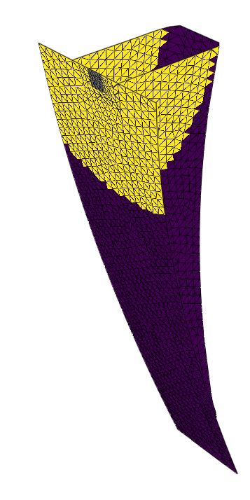
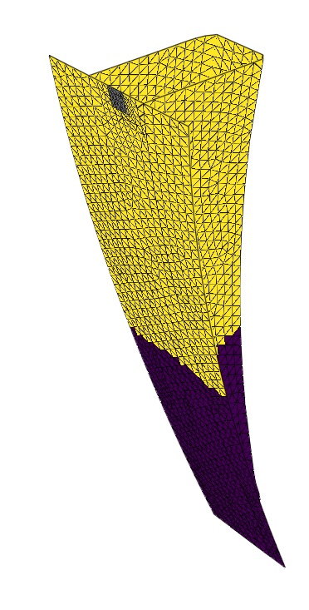
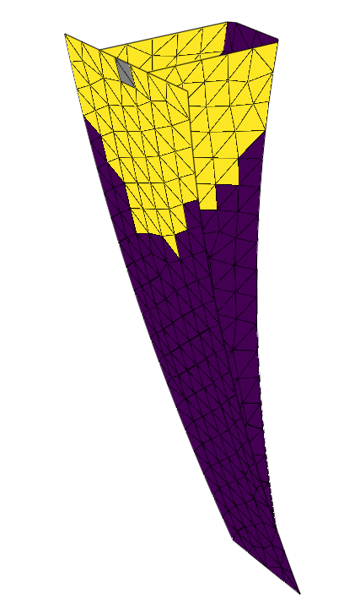
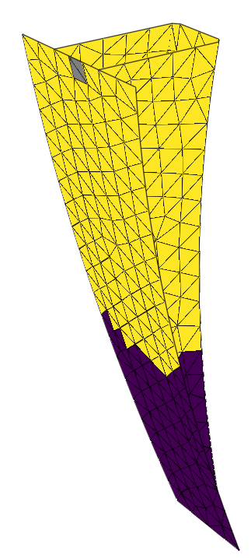
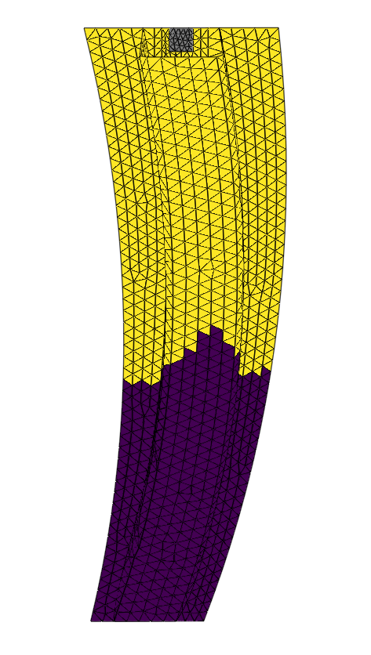
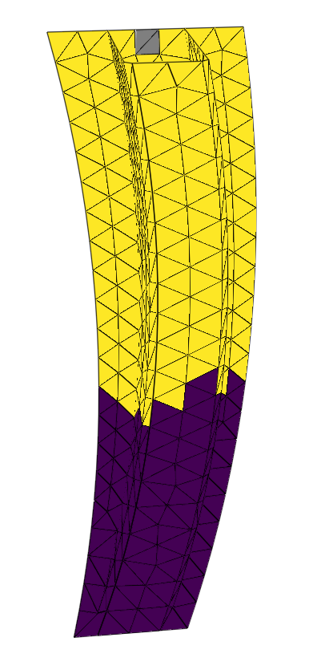
RTMsim vs. ANSYS Fluent
RTMsim vs. myRTM
The results for the new simulation tool with the fine mesh are in good agreement with the ANSYS Fluent results for both filling pattern and filling time. myRTM shows similar filling patterns for same filling degrees as the new simulation tool with the coarse mesh. This comparison shows that a coarse mesh can be used for filling simulations where only the flow front propagation is investigated, if the filling time is important a mesh refinement study must be performed.

